Slide 1


Slide 2

UNIVERSIDAD LA SALLE TEACHERS' FORUM MEXICO CITY
Three Touchstones To Identity
June 18, 2018
Br. Robert Schieler, FSC
Superior General

Slide 3
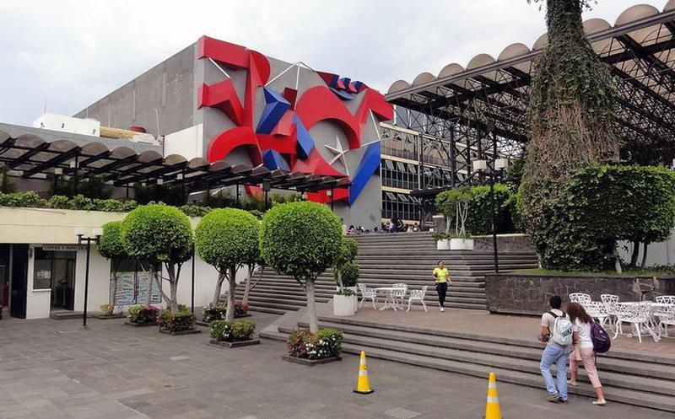
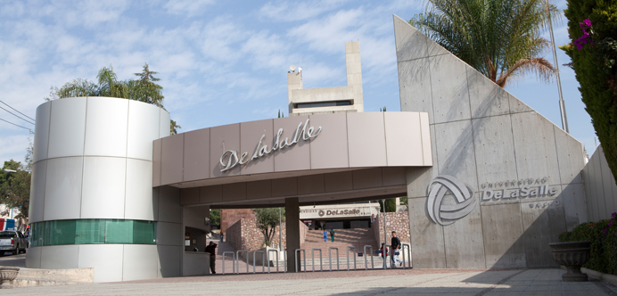
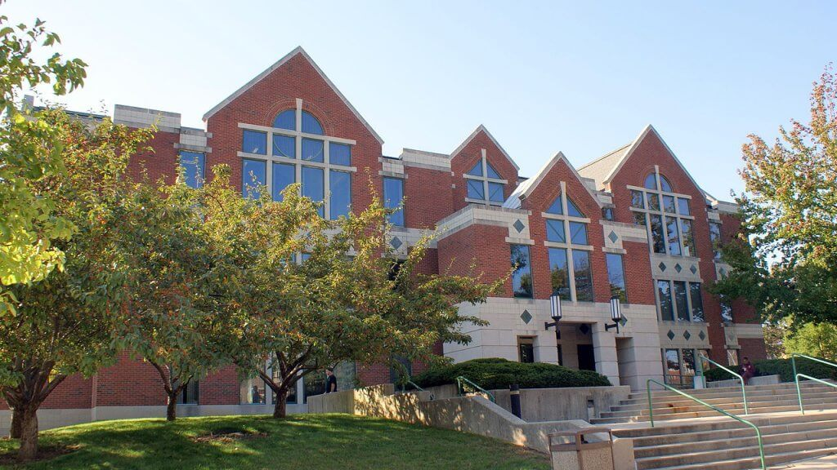
There is no universally applicable Lasallian solution.
Universidad La Salle in México City,
Universidad De La Salle Bajío in León and La Salle University Philadelphia

Slide 4
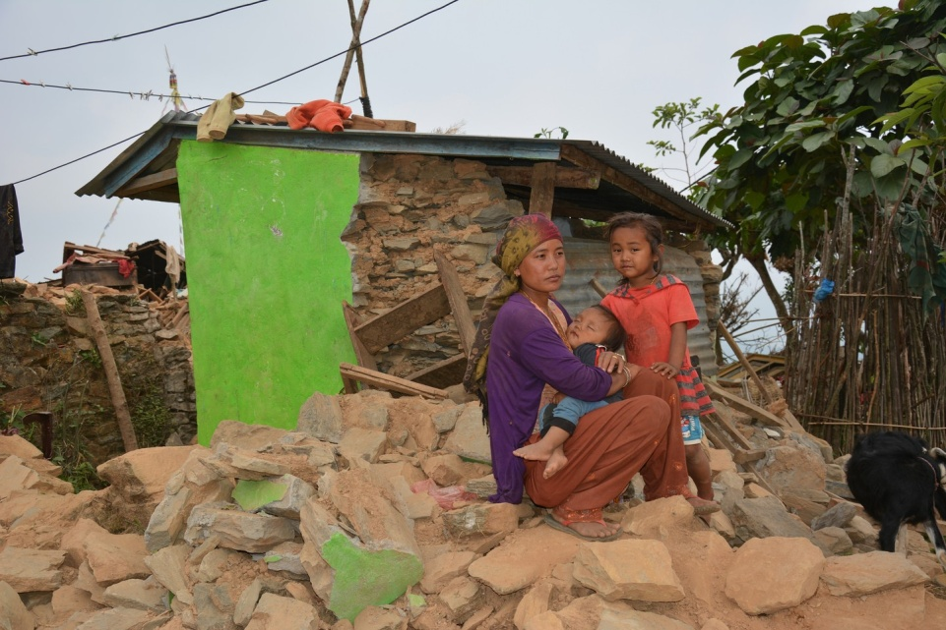
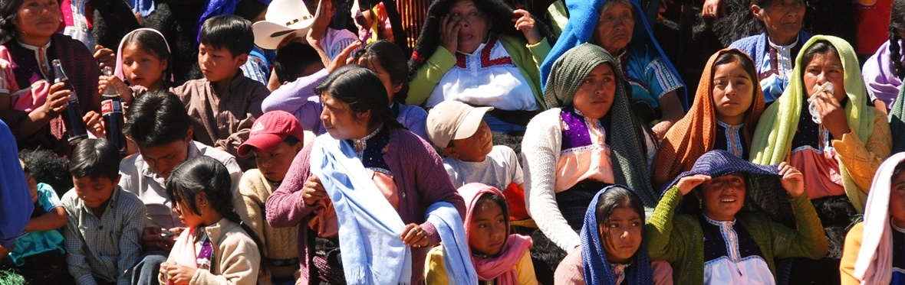
However, we know that in our hemisphere there exists
the persistent scourge of injustice: the unbroken cycle
of poverty for many of our people;
the devastation of indigenous people and their culture,
and ingrained political corruption.

Slide 5
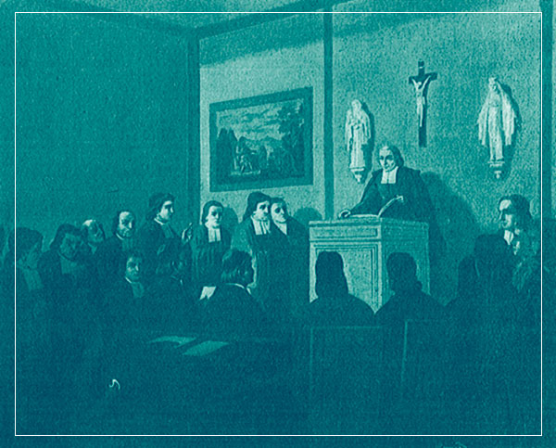
He left as his legacy a new type of school system for the elementary education of the poor, a new set of standards that would transform teaching school into a profession and a vocation, a new community of consecrated lay teachers, as a new form of religious life in the Church.¹
¹ Salm, Luke, FSC. Is the Lasallian University an Oxymoron? Paper delivered at Christian Brothers University, Memphis, TN, March 17, 1998.

Slide 6

“
According to the UNESCO report prepared for the 2009 World Conference on Higher Education, tertiary education is being influenced by five main factors: the impact of globalization, the phenomenon of massification, increasing inequalities access, increasing student mobility and information and communication technologies. ²
”
² Caniglia, Mattia. The Challenges of Higher Education in the 21st Century, Bullseye- Magazine, http://www.bullseye-magazine.eu/issues/, no. 69, 7 October 2017.

Slide 7
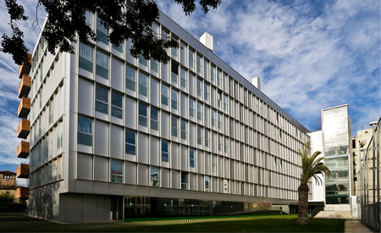
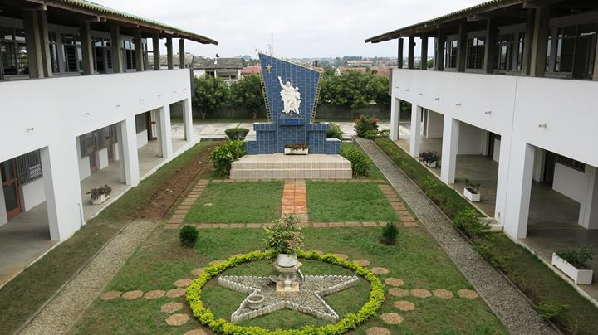
La Salle Campus Universitat Ramon Llull in Barcelona
CELAF
Centre Lasallien Africain

Slide 8
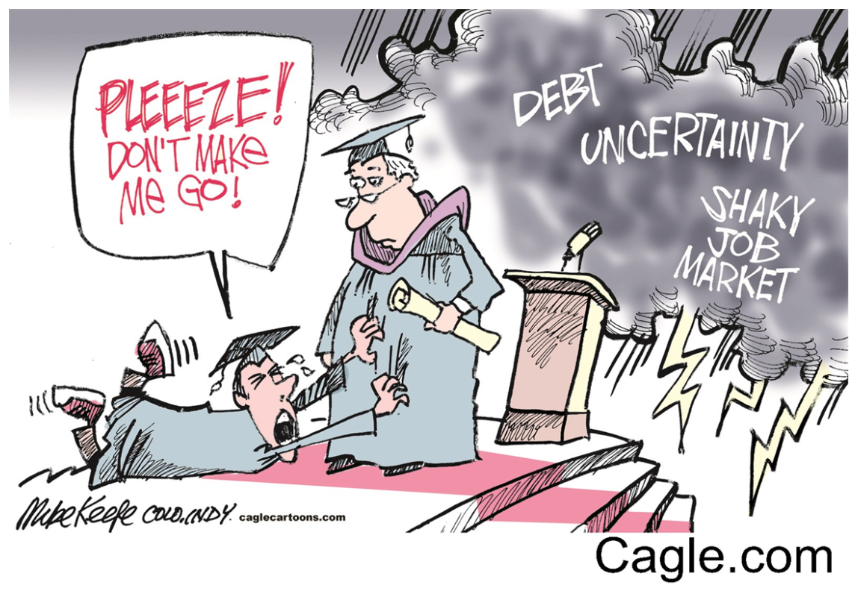
International research shows the curricula of Catholic secondary schools are increasingly becoming dominated by the pressures of conforming to the requirements of the nation states. These requirements are generally expressed in economic and utilitarian terms and evaluated by criteria of measurable outputs.

Slide 9


Fabians used to call
Brain Workers

Slide 10
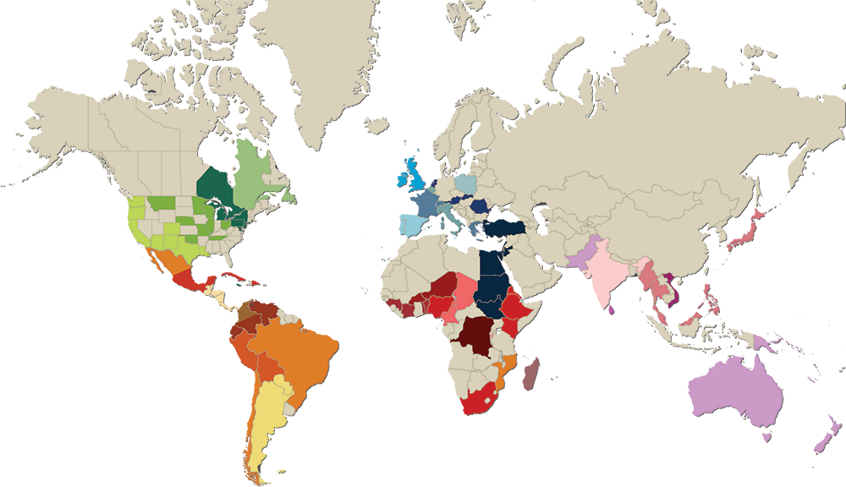
The centers of higher education that you represent are important members of the world-wide
Lasallian Family where every day
1.000.000 Students
gather to share the joy of the Gospel – solidarity, respect, mercy and justice - in a first class educational environment.
Approximately 200,000
Lasallians
79
Countries
3,600 Brothers
are enrolled in our communities
of tertiary education;
almost one fifth
of our total student population. “Catholic and Lasallian”
is what unites us.
90,000
Partners

Slide 11
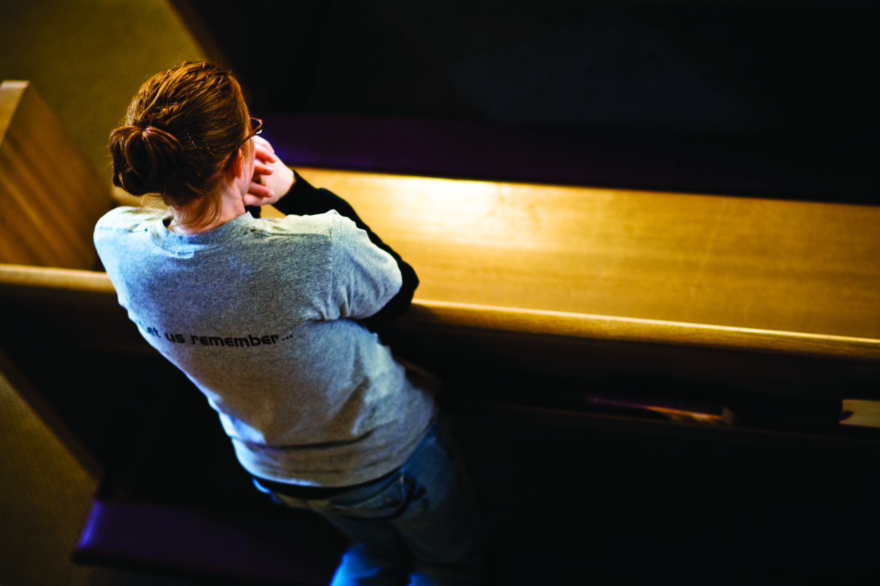
The Presence of God
La presencia de Dios
La présence de Dieu

Slide 12
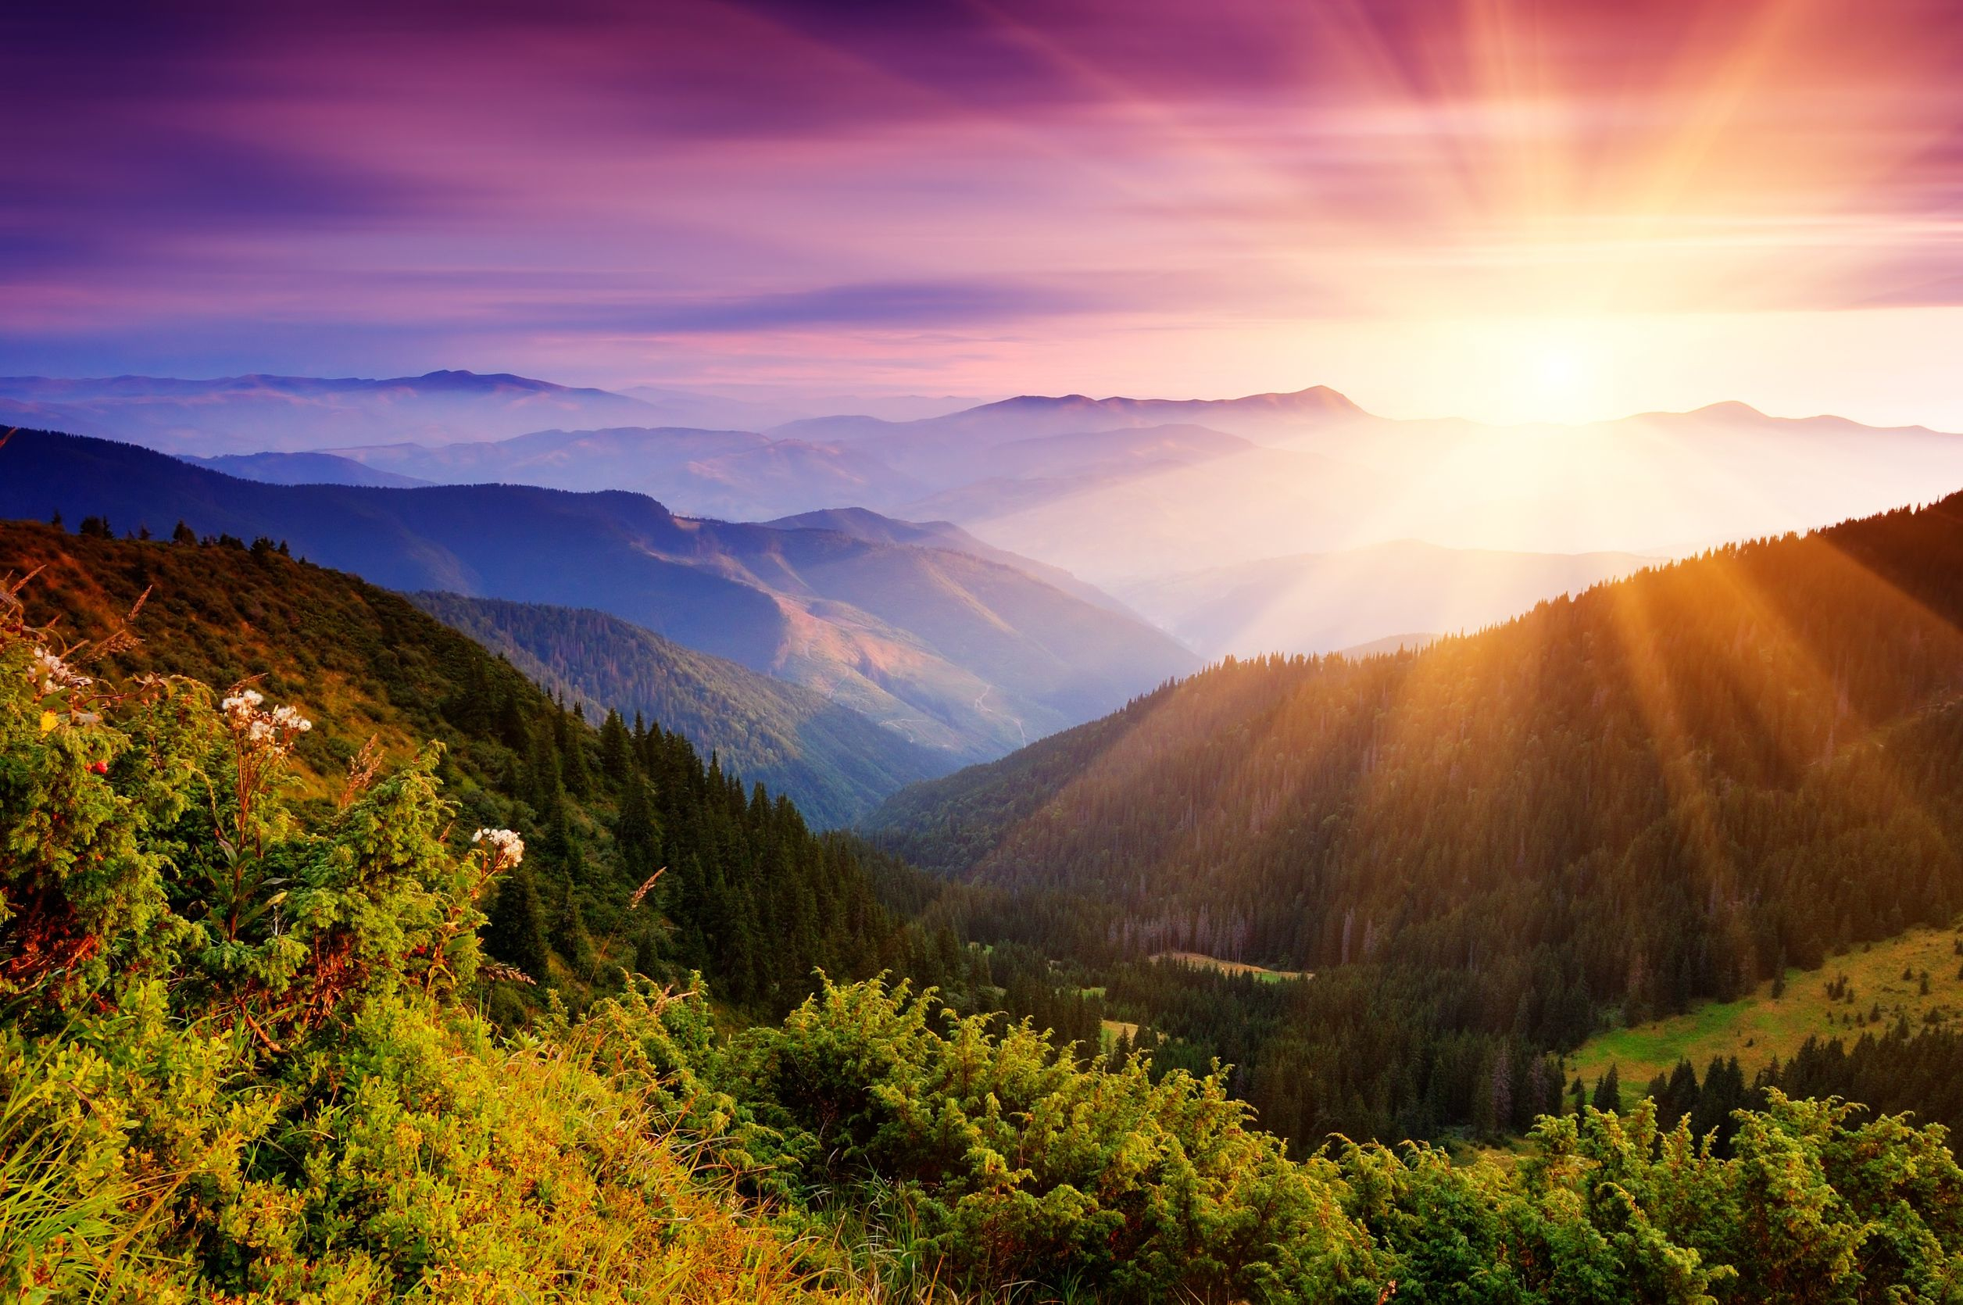
With Gerard Manley Hopkins, we should inspire our students to delight in the grandeur of God revealed through creation
Como dice Gerard Manley Hopkins, debemos inspirar a nuestros estudiantes a deleitar la grandeza de Dios revelada a través de la creación
Avec Gerard Manley Hopkins, nous devrions inspirer nos élèves à se délecter de la grandeur de Dieu révélée dans la création

Slide 13
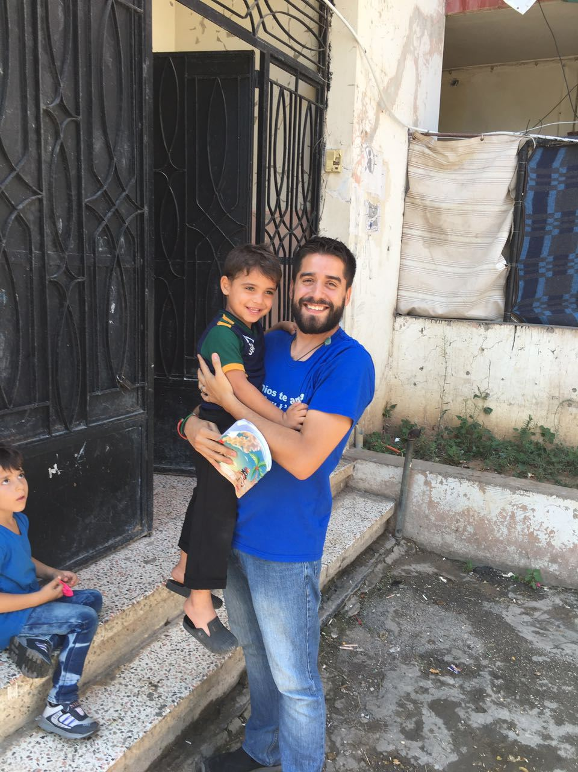
Our centers of higher education can invite Lasallians to strap on backpacks and joyfully serve Syrian refugees in the name of God at our Fratelli Project in Lebanon or teach children in the name
of God in South Sudan.

Slide 14
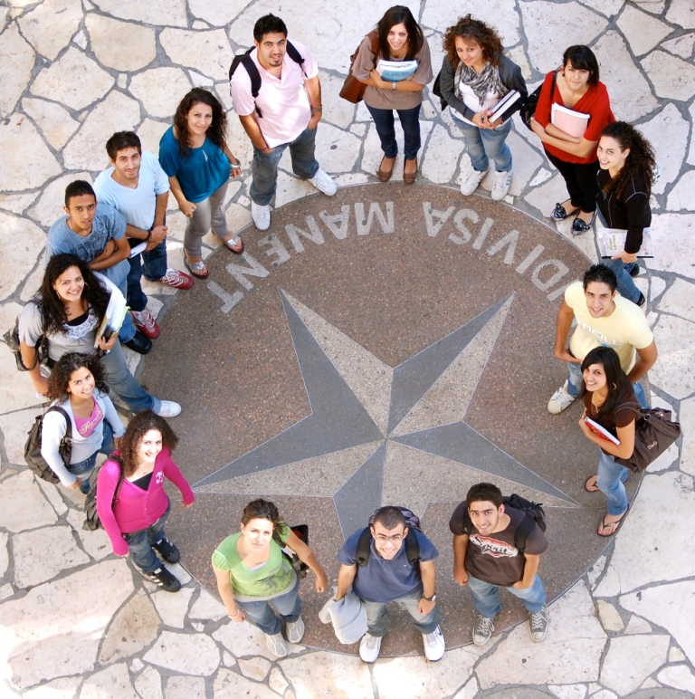
The tangible sense of God’s presence felt on the campus in Bethlehem springs from our conviction that all persons – no exceptions – are the image and likeness of God

Slide 15



Referring to new modes of virtual presence as a means of personal encounter, I note that “Perhaps the most positive educational implication of all of this, for the Catholic educator, is the capacity of the new digital media to create new communities by responding to the human need for relationship and participation.” ⁴
³ Hopkins, Gerard Manley, https://www.poetryfoundation.org/poems/44395/gods-grandeur.

Slide 16
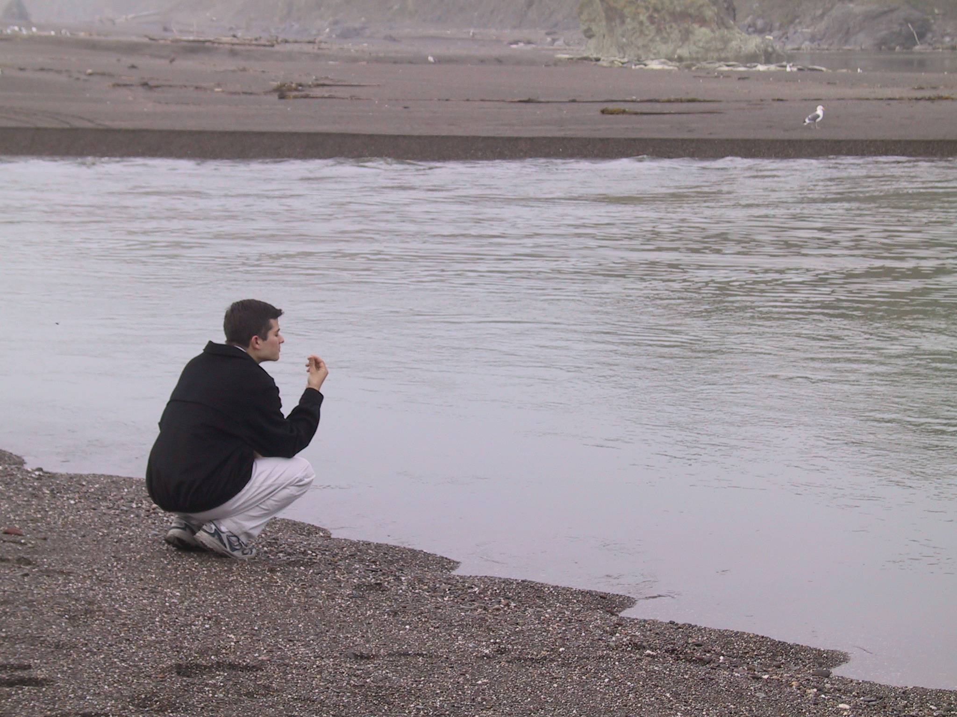
“Which side of the river are you standing on
as you ask your questions?
Can you see that there are just as
many unanswerable questions
that you can ask from
the other side of the river?

Slide 17
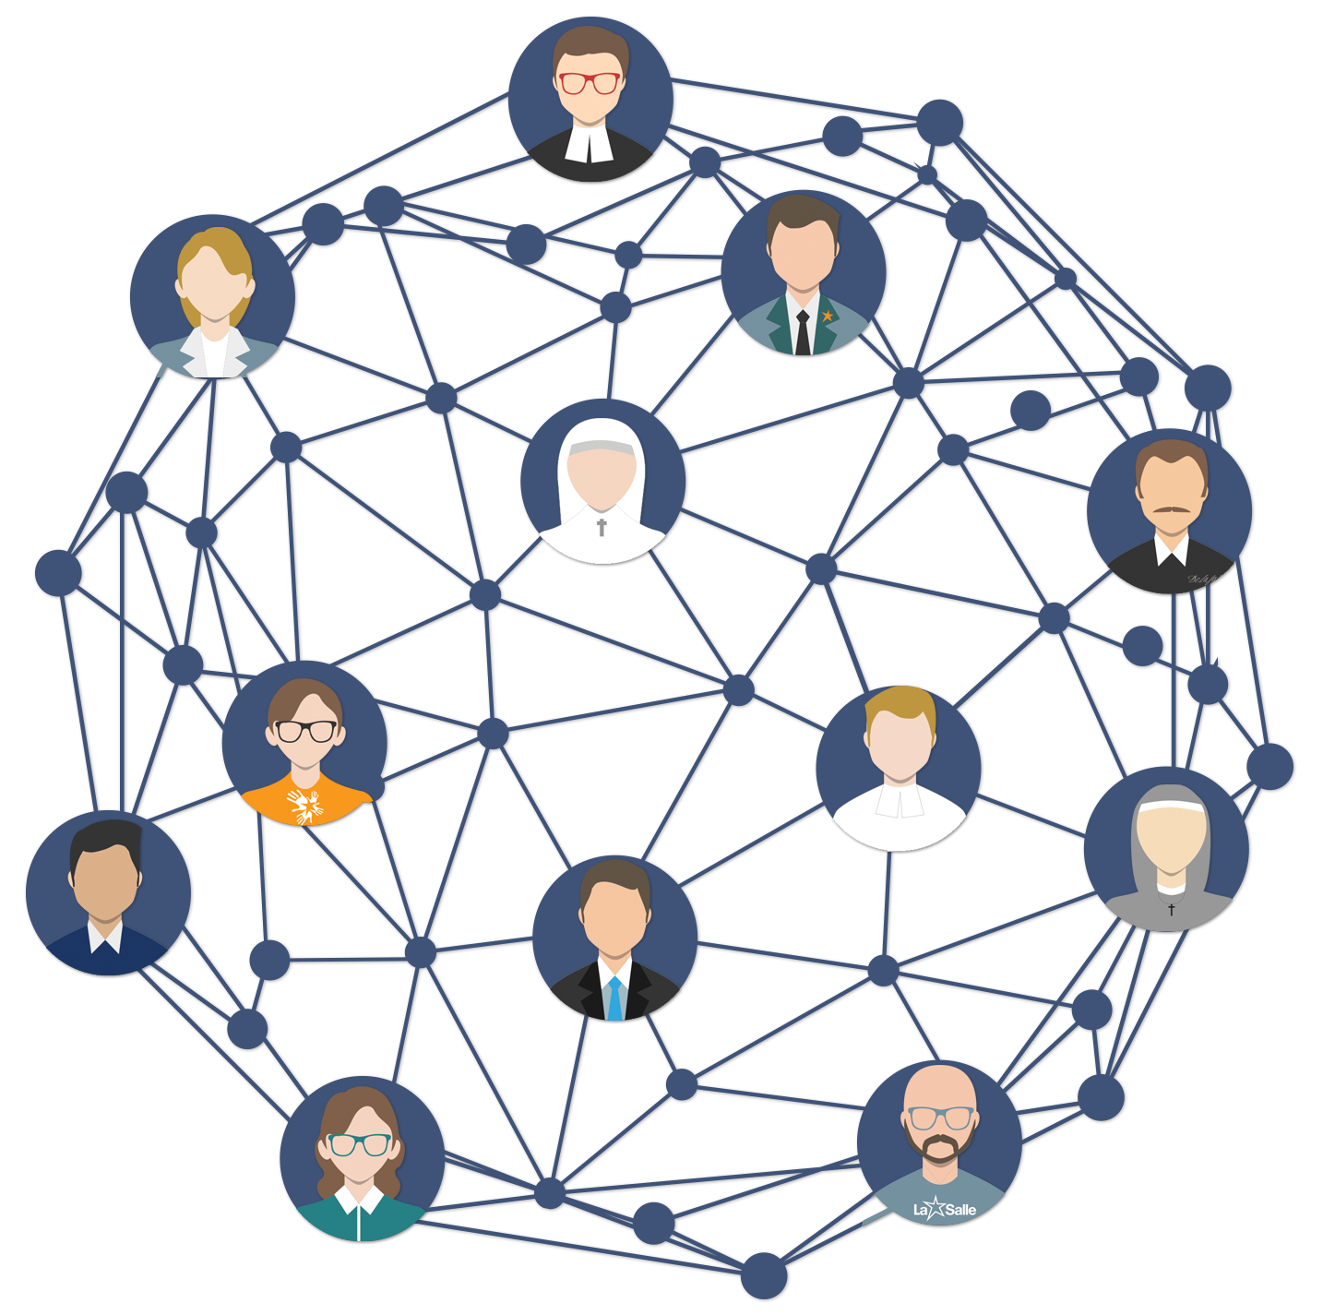
The Second Touchstone:
Segundo hito:
La deuxième pierre de touche :
Community
Comunidad
Communauté

Slide 18
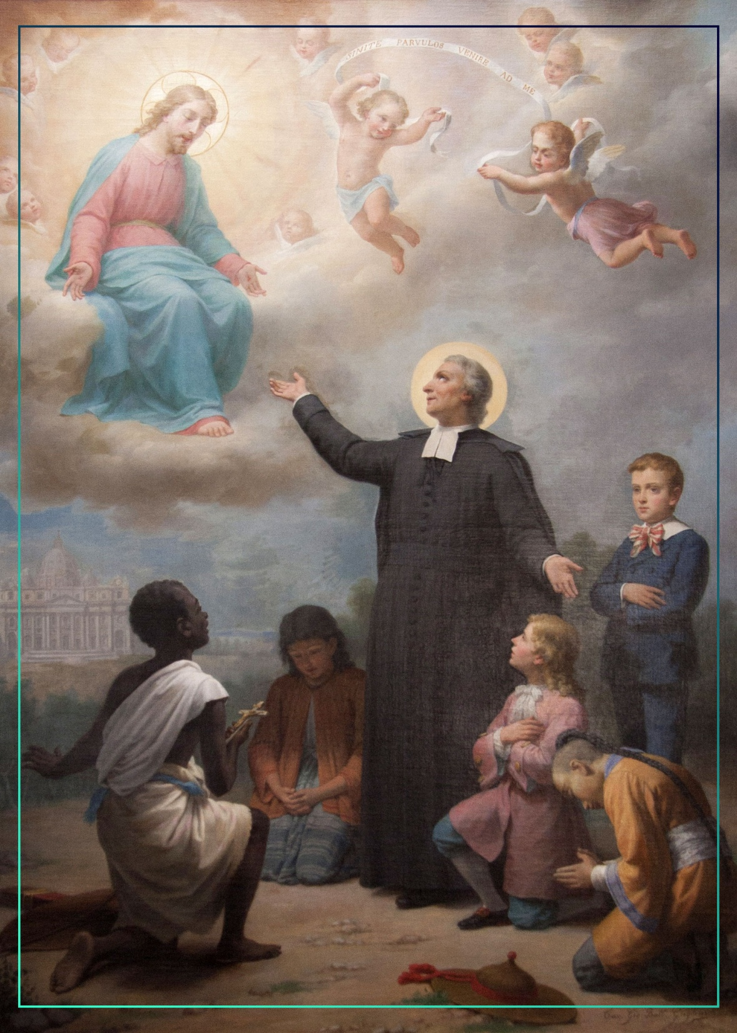
We are disciples of
Jesus Christ and
John Baptist de La Salle,
two attractive and provocative personalities who move us to procure the wellbeing of all those entrusted to our care.

Slide 19
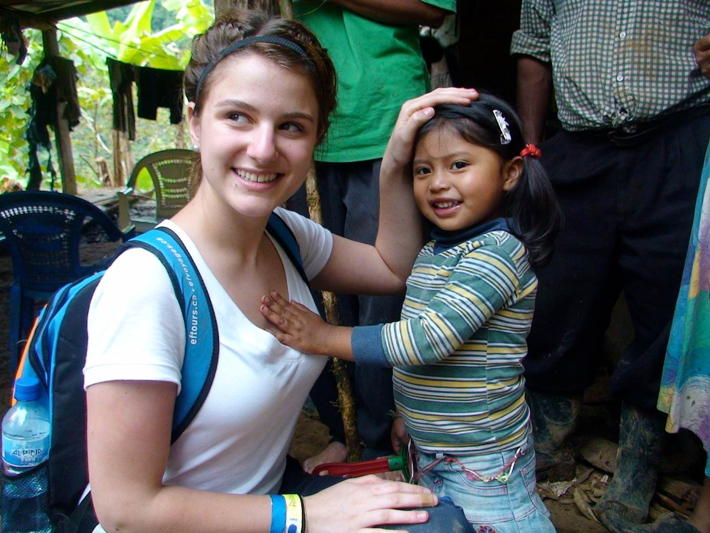
The third Touchstone:
Service
Tercer hito:
Servicio
LA troisième pierre
de touche:
Service

Slide 20

Educación para la participación y el compromiso político. La política necesita urgentemente nuevos aires, una nueva generación de políticos que realmente se preocupen por el bienestar de las personas.
Educación para involucrarse en discusiones sociales esenciales con respecto a la ética, la protección ambiental, la salud y la nutrición.
Educación para el uso adecuado de la tecnología, atención especial a la potencial de la manipulación de las redes sociales para crear noticias falsas, verdades parciales y opiniones enmascaradas como hechos.

Slide 21

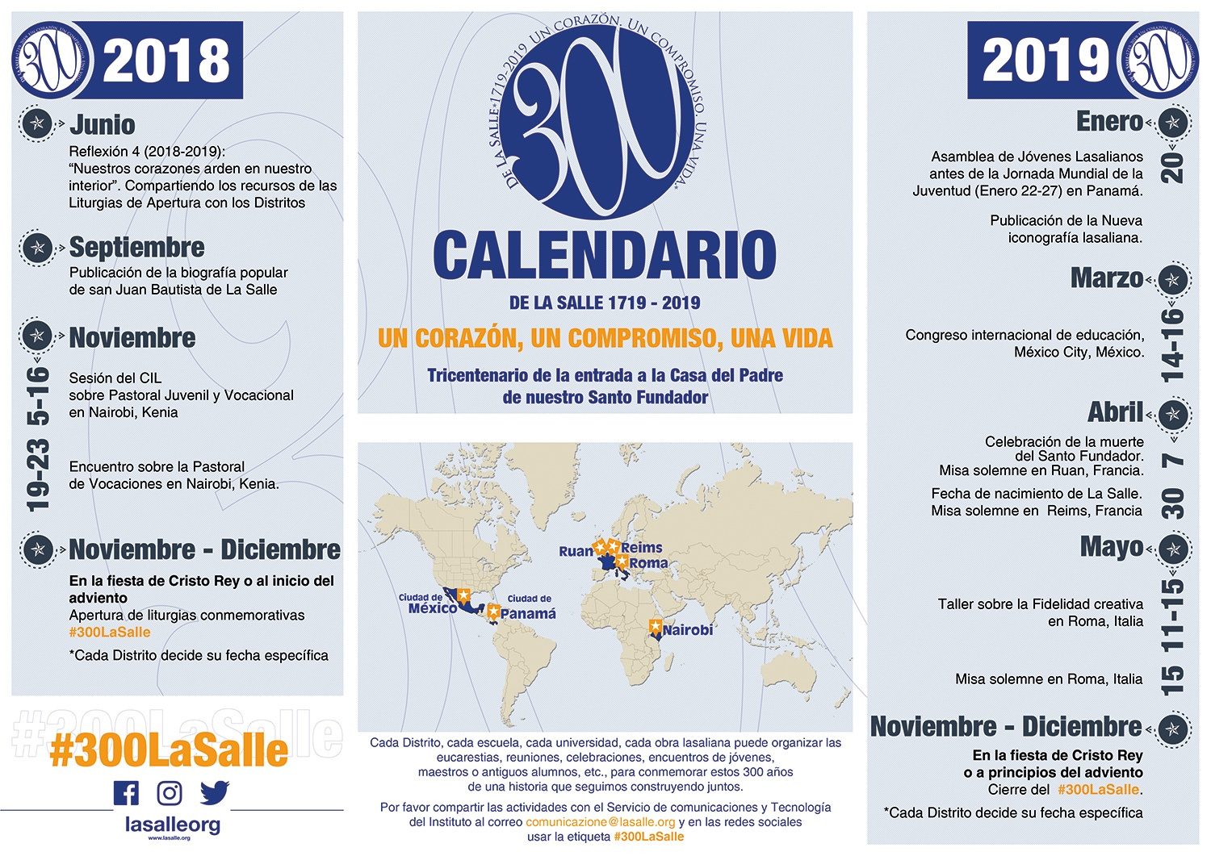

2019
Year of
Lasallian Vocations

Slide 22
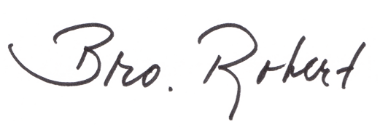

Thank you | Gracias | Merci

